Slide 1
DEMENTIA DETECTION USING CNN, NLP AND CARE-TAKER APPLICATION
Team Members:
A. Akshitha - 18071A0502
Ch. Sankranthi - 18071A0510
K. Sravya - 18071A0527
S. Shanmukha Anurag - 18071A0551
Guide:
Dr. B. V. Kiranmayee
Professor
VNRVJIET

Slide 2
TABLE OF CONTENTS
01. Abstract | 02. Introduction
03. Literature Survey | 04. Existing Systems
05. Proposed System | 06. System Requirements
07. System Architecture | 08. Modules
09. UML Diagrams | 10. Implementation
11. Results | 12. Test Cases
13. Conclusion | 14. Future Scope
15. References | 16. Status of the Work

Slide 3
01.
ABSTRACT

Slide 4
ABSTRACT
According to the World Health Organization (WHO), dementia is “an umbrella term for several diseases affecting memory, and behavior that interfere with a person's ability to maintain their daily living activities. It is not a normal part of aging”.
Dementia is caused by physical changes in the brain. Many different diseases can cause dementia. Drugs are available to alleviate some of the symptoms, but they do not cure it.
Alzheimer's is the most common type of dementia, but there are many kinds. Dementia is best characterized as a syndrome rather than as one particular disease.
The causes of dementia are myriad and include primary neurologic, neuropsychiatric, and medical conditions. It is common for multiple diseases to contribute to any one patient's dementia syndrome.

Slide 5
02.
INTRODUCTION

Slide 6
INTRODUCTION
Early diagnosis of Alzheimer’s disease plays a pivotal role in patient care and clinical trials.
In this study, we try to develop a new approach based on 3D deep convolutional neural networks to accurately differentiate mild Alzheimer’s disease dementia from mild cognitive impairment and cognitively normal individuals using structural MRIs.
For comparison, we built a reference model based on the statistical data of the patients and performed classification using the factors given below:
Years of Education
Socio Economic Status
Mini Mental State Exam
Clinical Dementia Rating
Estimated Total Intracranial Volume
Normalize Whole Brain Volume
Atlas Scaling Factor

Slide 7
INTRODUCTION
The deep-learning model is more accurate and significantly faster than the classification model.
The model can also be used to forecast progression, re-validate the misinterpreted information and also diagnose if the patient has dementia or not based on the MRI scans and OASIS datasets.
An analysis of the features learned by the proposed model shows that it relies on a wide range of regions associated with Alzheimer's disease. These findings suggest that deep neural networks can automatically learn to identify imaging biomarkers that are predictive of Dementia and leverage them to achieve accurate early detection of the disease.
Further analysis of the Mini Mental State Exam using Natural Language Processing is done to further improve the model performance and remove irregularities.
The present model not only detects dementia using ML techniques, but also uses it further to create an app to support dementia affected people with care.

Slide 8
03.
LITERATURE SURVEY

Slide 9
S.No. | Title of the Paper | Methods | Pros/Cons | Year
1 | Using Machine Learning to Predict Dementia from Neuropsychiatric Symptom and Neuroimaging Data | Alzheimer’s Disease Neuroimaging Initiative data set, Clinical MRI data, Statistical Analysis, Feature Selection and Classification. | Cons: Focuses on only single Image Modality which results in low accuracy, substantial error measurement found in mild behavioral impairment positive (MBI+), one of the factors for dementia. Pros: Techniques would be helpful in early detection of dementia. | 2020
2 | Machine Learning for the Preliminary Diagnosis of Dementia by Fubao Zhu, et al. | Random Forest, AdaBoost, LogitBoost, Neural Network, Naive Bayes, and Support Vector Machine | Cons: The study was conducted only in three hospitals, which may show selection bias. More subjects are needed to validate the method. | 2020
3 | Machine Learning Techniques to Identify Dementia by Shanta R | Support Vector Machine, Linear Discriminant Analysis and K-Nearest Neighbour Algorithms | Pros: The techniques diagnosis of disease at early stages but a larger dataset can be used to obtain more accuracy. | 2020
4 | Spatiotemporal formal extraction and classification of Alzheimer’s disease using deep learning 3D-CNN for fMRI data | fMRI and deep learning techniques, 3D CNN data extraction and classification steps | Cons: fMRI technique needs to be developed for this problem statement, more training of CNN model is required, each kernel type has its own limitations and advantages which doesn’t make one superior over the other. | 2020

Slide 10
S.No. | Title of the Paper | Methods | Pros/Cons | Year
5 | Prevalence and incidence of Alzheimer's disease in Europe: A meta-analysis | Conducted a literature search on Medline, Scopus, and CINAHL Complete using keywords; Bayesian random effects model was used. | Pros: Meta-analysis allows a better grasp of the impact of this disease. | 2018
6 | Identifying Incipient dementia Individuals using Machine Learning and Amyloid Imaging by Sulantha M., et al. | CIVET image processing pipeline, ML algorithm, logistic regression analysis, RUSRF (Random Under Sample Random Forest) novel algorithm in the scikit-learn library | Cons: The patterns learnt by the predictor might not be specific to Alzheimer's disease because its diagnosis can only be confirmed with autopsy data. | 2017
7 | Early Diagnosis of Dementia from Clinical Data by Machine Learning Techniques by Aram So, et al. | Support Vector Machine, Naive Bayes, Logistic Regression, Multilayer Perceptron, Random Forest | Diagnoses dementia at early stages in a fast, inexpensive and reliable way. Model is not very precise and accuracy can be improved. | 2017
8 | The ALFA project: A research platform to identify early pathophysiological features of Alzheimer's disease | The ALFA parent cohort baseline visit included full cognitive evaluation, lifestyle habits questionnaires, DNA extraction, and MRI. | Fulfillment of the study inclusion criteria, the 3102 assessed participants underwent a cognitive screening. | 2016

Slide 11
S.No. | Title of the Paper | Methods | Pros/Cons | Year
9 | MOBI-COG: A mobile application for instant screening of dementia using the mini-cog test | Use local database for displaying words on the screen.Pre-processing, feature extraction, training and classification for clock drawing test.,k-NN algorithm for classification of recognized digits. | Pros: convenient, automated and easy to administer dementia screening test that can be taken at home. | 2014
10 | Conducting Cognitive Exercises for Early Dementia With the Use of Apps on iPads | Keyword based app selection from iTunes, Questionnaire to determine the familiarity of the participant with technology, Finalize the apps based on a questionnaire. | Cons:Cognitive training and daily living | 2015
11 | Ticket to Talk: Supporting Conversation between Young People and People with Dementia through Digital Media | Extend the previous work by developing an application that incorporates the following four design requirements: (1) Setting up a profle. (2) Inspiration (media to use for talk). (3) Collecting media. (4) Preparing a conversation | encourage conversation between younger people and their old relatives living with dementia. | 2018

Slide 12
S.No. | Title of the Paper | Methods | Pros/Cons | Year
12 | Mobile Technology for Cognitive Assessment of Older Adults: A Scoping Review | To evaluate the cognitive skills by involving different tests for cognitive functions assessment | Pros:.Better correlation which meant the experiment was meaningful | 2015
13 | The CAIDE Dementia Risk Score App: The development of an evidence-based mobile application to predict the risk of dementia | Aim: To predict the risk of dementia through CAIDE (cardiovascular risk factor, ageing and incidence of dementia) Risk Score app. (i) Development of app based on CAIDE dementia risk score by involving information on age, educational level, hypertension, hypercholesterolemia, obesity, and physical inactivity. | Cons:The factors taken into consideration can be improved by considering more features | 2018
14 | Pervasive assistive technology for people with dementia: a UCD case | A UCD (User-centred design) to investigate the adoption of pervasive assistive technology among mild dementia people. | Cons: System Usability Scores (SUS) in usability testing and field testing can be improved | 2016

Slide 13
04.
EXISTING SYSTEMS

Slide 14
EXISTING SYSTEMS
Doctors diagnose dementia based on a careful medical history, a physical examination, laboratory tests, and the characteristic changes in thinking, day-to-day functioning and behavior associated with different types of people and symptoms.
They perform cognitive and neurological tests, brain scans, psychiatric evaluation, genetic tests, blood tests among others.
Many machine learning algorithms were developed in the areas of cognitive, neurological tests and evaluation tests by the use of NLP and classification methods. In addition, brain scans are analyzed with the help of neural networks and image analysis.

Slide 15
EXISTING SYSTEMS
SVM methods were used along with kernel functions, and a few other methods like K Nearest Neighbours are used to identify a pattern among people suffering from dementia.
SVM came close in separating the data points using a hyperplane thus solving the problem of multiclass classification but there was a decline in accuracy while predicting the outcome finally.
Later, KNN was used to overcome the "quantifiability of the stages in dementia" with radial functions, but the following method had issues with the size of the dataset being too small or too large leading to inaccuracy or vastly increasing the time consumed.
Although there are some decent systems that detect dementia and provide informative articles, there is no application that brings all the services together - from detecting to providing assistance to the affected ones.

Slide 16
05.
PROPOSED SYSTEM

Slide 17
PROPOSED SYSTEM
The proposed system focuses on building a product utilising these results from the classification methods and helping the patients with dementia in daily care. Additionally, it supports by providing exercises to improve cognitive responses to improve memory and also backup the product with data analysis to improve the classification model in turn.
The product is going to be designed in a way which can be used either by the patient or the care taker based on the stage of dementia the patient is in, trying to maintain the same stimuli of functions.

Slide 18
PROPOSED SYSTEM
While there can be user-base with special needs, we tried to include the audience based on the limitation and projections of the project.
Building a product for a patient with any stage of dementia is necessary. But patients with the need of physical and mental help are categorised accordingly. It is important for the individual to understand English to access some features of the product.
While taking continuous data from the patient, the product would also be able to generate regular diagnostic reports which can be shown to the doctor of consent, when clinically approved. The product will also have a flexibility to add the doctors improvements and alter the functions of the product accordingly.

Slide 19
06.
SYSTEM REQUIREMENTS

Slide 20
FUNCTIONAL REQUIREMENTS
Service
To be able to accurately diagnose whether a person is demented or not using CNN.
To be able to score the Mini Mental State Exam using NLP.
Product
To be able to build a product which will help the demented patient improve his cognitive responses.
To be able to help the caretaker of the patient suffering from dementia and decline in cognitive responses.
Both service and the product to be used by many patients with dementia and people to diagnose whether they are demented or not.

Slide 21
NON-FUNCTIONAL REQUIREMENTS
The diagnostic and clinical reports must be generated carefully and in a short period of time.
The user’s data must be inserted into the database sequentially so that there would be no scope for mismatches and loss of input data.
The final feedback report must be updated in the same user’s profile so that it is properly analyzed by the model.
User interface of the application must be interactive and uncomplicated as it is even used by dementia affected people.

Slide 22
HARDWARE AND SOFTWARE REQUIREMENTS
Hardware requirements:
Processor: Intel Core i3 2.53 GHz or above
RAM: 2GB or above
HDD : 120GB or above
Software requirements:
Operating system: Windows XP and above
Developing environment: Python 3.6

Slide 23
07.
SYSTEM ARCHITECTURE

Slide 24
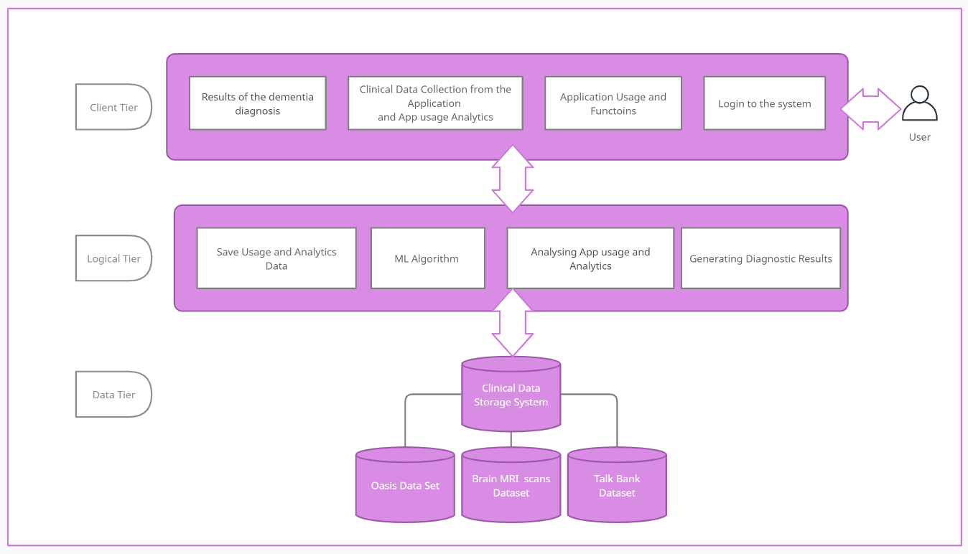
SYSTEM ARCHITECTURE

Slide 25
08.
MODULES

Slide 26
Application User Form
Data Collection
Data Analysis
Pre-processing of Data
Feature Extraction
Classification of Data
CNN
NLP
Evaluation of Data
Functions and Activities
Report Generation
Analysis

Slide 27
09.
UML DIAGRAMS

Slide 28
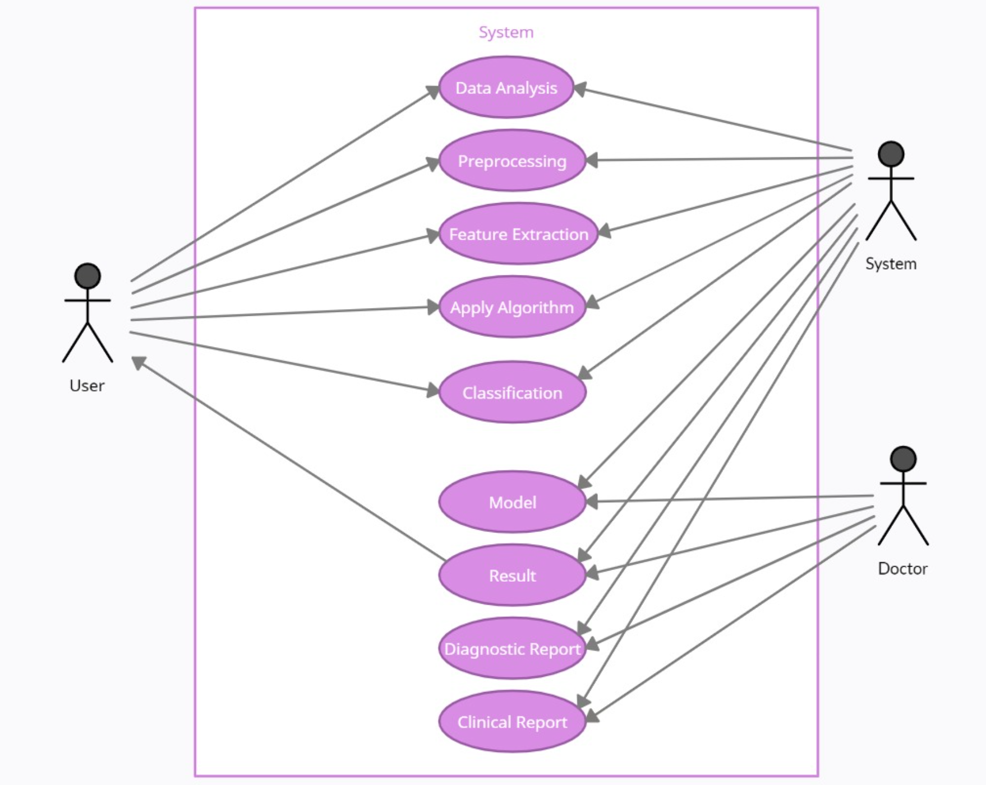
USE CASE DIAGRAM

Slide 29
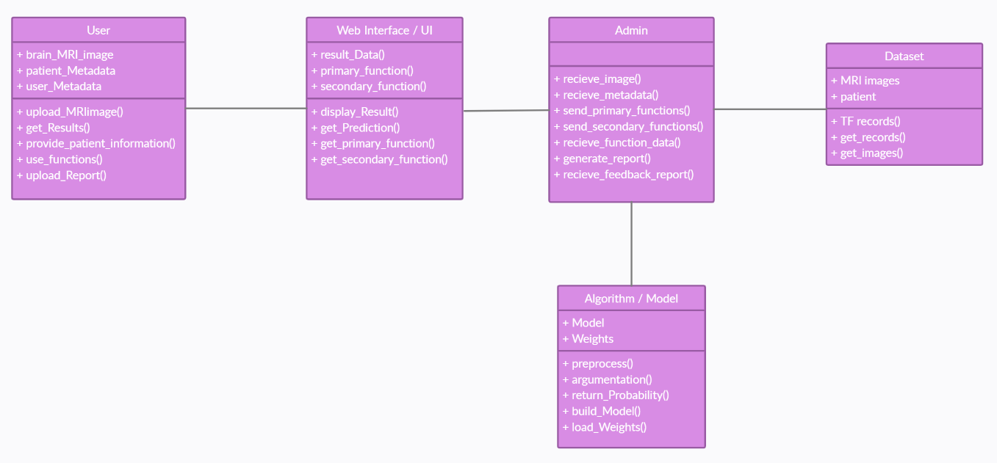
CLASS DIAGRAM

Slide 30
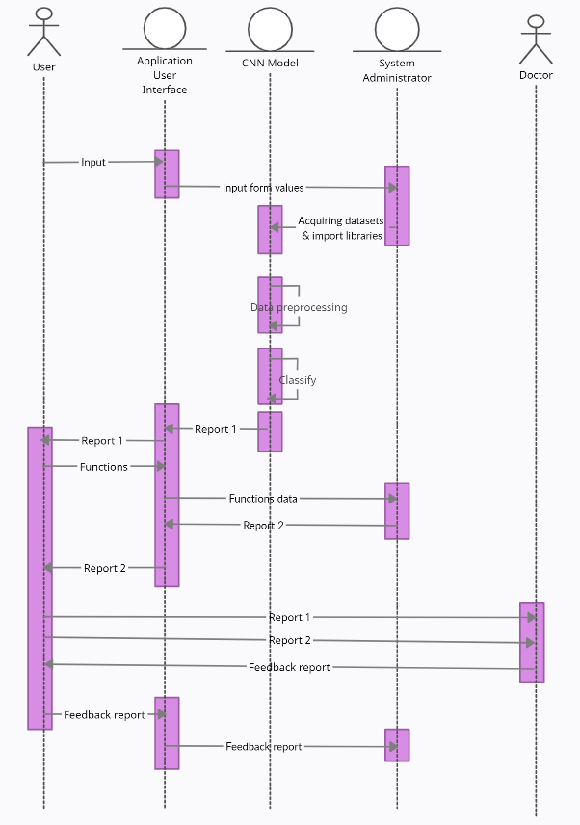
SEQUENCE DIAGRAM

Slide 31
10.
IMPLEMENTATION

Slide 32
IMPLEMENTATION
The implementation has been divided into 3 major modules:
Data Classification
Usable features based on the severity of the demented patient
Data Analysis

Slide 33
DATA CLASSIFICATION
Data Classification is an ensemble classification of Random Forest Classification over dataset with features such as age, MMSE score, years of education, socio economic status, among others and 3D CNN classification method over MRI images and usage of NLP methods to identify biomarkers over the answers given for the tests.

Slide 34
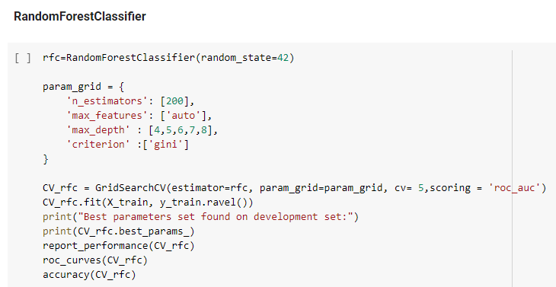
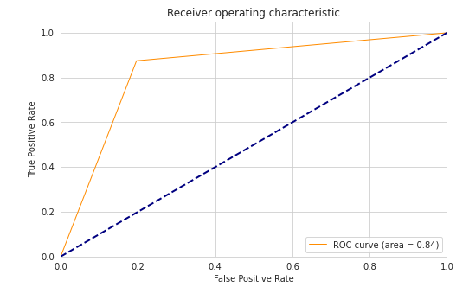
RANDOM FOREST CLASSIFIER
The random forest is a classification algorithm consisting of many decision trees. It uses bagging and feature randomness when building each tree to try to create an uncorrelated forest of trees whose prediction by committee is more accurate than that of any individual tree.
Random forest algorithms can be used for both classifications and regression tasks. It provides higher accuracy through cross-validation. A random forest classifier will handle the missing values and maintain the accuracy of a large proportion of data.

Slide 35
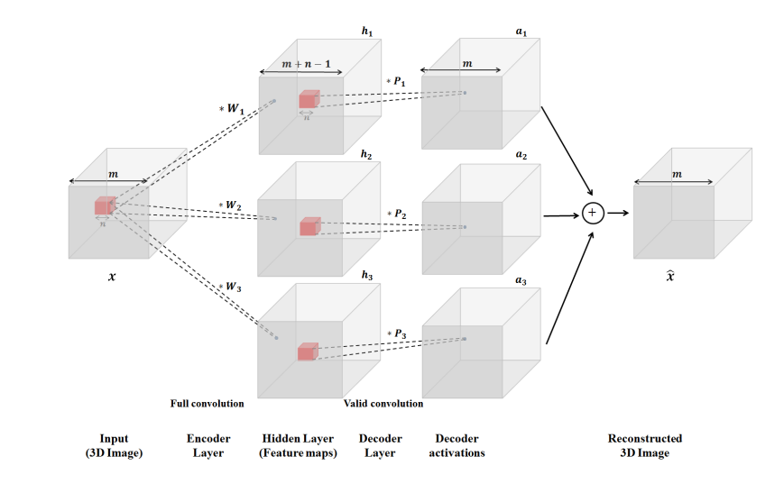
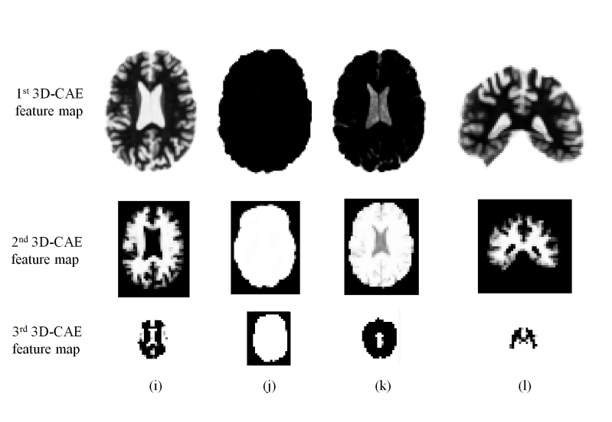
3D CNN CLASSIFIER
A robust diagnostic of a particular disease should adapt to various datasets, such as, e.g., MRI scans collected by several patient groups, as to diminish discrepancies in data distributions and biases toward specific groups. Deep learning aims to decrease the use of domain expert knowledge in designing and extracting most appropriate discriminative features.

Slide 36
NLP
A language variation can act as a proxy that monitors how a patient's cognitive functions have been affected (e.g., issues with word finding and impaired reasoning). The machine learning models can exploit these language patterns and thus help in diagnosing the patient.
Code for LSTM (Long Short Term Memory, which is a recurrent neural network technique) is done but comparing it with Particle Swarm Optimization Methodology.

Slide 37
USABLE FEATURES
Some usable features based on the severity of the demented patient are:
To-do Lists
Puzzles with personalized photos
Alarms and Reminders
Cognitive Questions and Games

Slide 38
TO-DO LISTS
Web Site ToDo-ist API call
https://rapidapi.com/dimas/api/Todoist/details
To-do lists can include API calls over:
Access Tokens
Resources
Project
Items
Tasks
Orders
Labels
Notes
Reminders

Slide 39
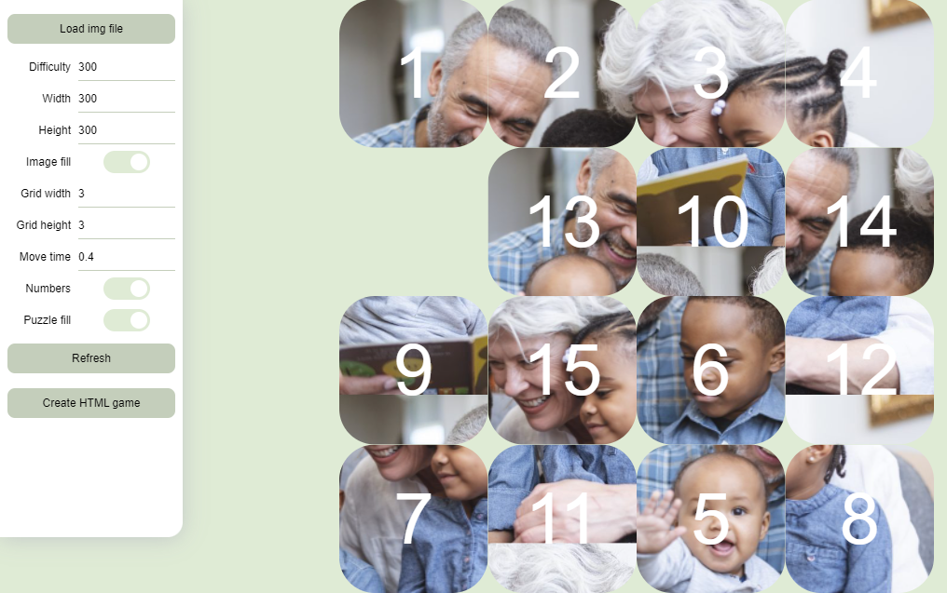
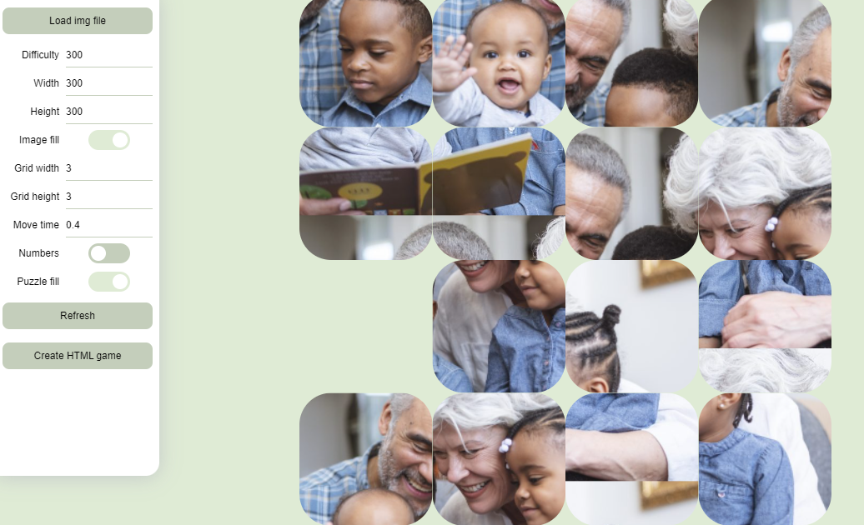
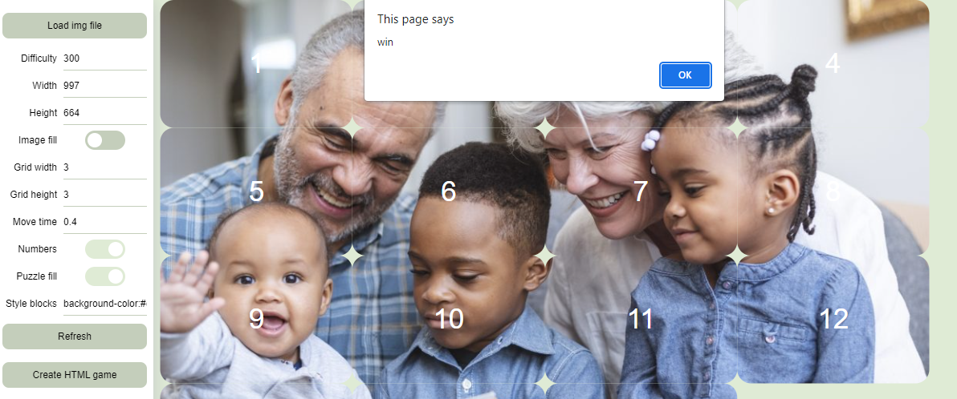
Puzzles with personalized photos

Slide 40
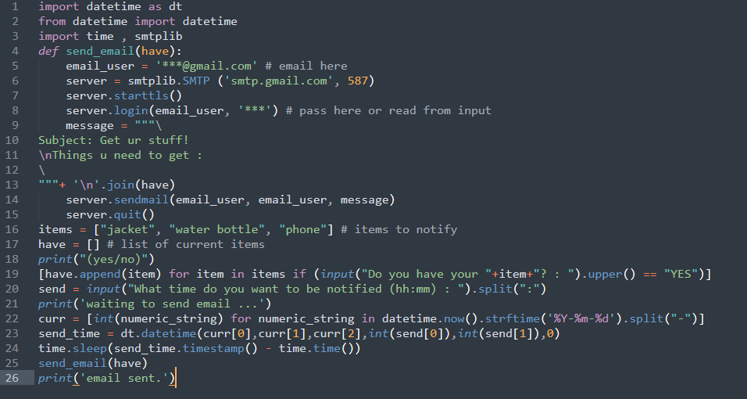
Alarms and Reminders
Python Application which can send mails

Slide 41
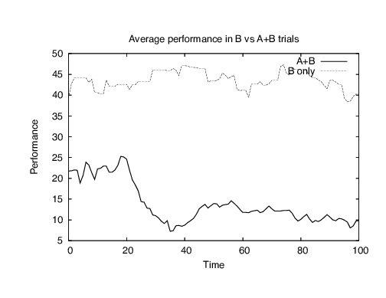
DATA ANALYSIS
All the data from the features will be sent to excel and analysis is performed using powerQuery functions.

Slide 42
11.
RESULTS

Slide 43
RESULTS
In the classification module of the project, the random forest classifier has given an accuracy of 84%, while the CNN one has achieved 86%. The NLP (LSTM) classifier has shown 84% accuracy.
In terms of the services provided by the application, patients can make use of reminders and alarms to try not to forget things. Additionally, they can use to-do lists and puzzles related to cognition and memory power.

Slide 44
12.
TEST CASES

Slide 45
TEST CASE RESULTS
After considering many test cases, we finally concluded that the prototype works with about 84 percent accuracy.
Test case fails at:
Absence of input fields
Input data of String data type
Gender attribute containing a value other than the Boolean equivalent

Slide 46
TEST CASE RESULTS
TYPES OF TEST CASES | RESULT
Proper input data values | PASS
Absence of input data (all fields of input data contain no values) | FAIL
Facilitating partial input data | PASS
Input data of type String | INVALID
Float input data type values | PASS
Gender attribute contains data other than 0 or 1 | INVALID

Slide 47
13.
CONCLUSION

Slide 48
CONCLUSION
Dementia cannot be cured as a syndrome that affects memory, but its symptoms can be mitigated.
In order to act upon this syndrome, dementia needs to be identified effectively, this is done at 84.82% accuracy using an Extra Tree Classifier specified in the proposed system. This was the accuracy obtained after facing many challenges like complex neural network image analysis and unavailability of data.
Multiple classification methods helped us obtain the best accuracy, result and gave a clear idea on which classification method is beneficial with such inadequate data and model.
MRI images obtained from medical tests needed to be analyzed and further explored excessively using image processing. The mini-mental state examination data can be further used to accurately classify dementia.
Furthermore, the available and acquired data can be used to treat patients in a more effective way focusing on deprived areas.
In addition to this, patterns between the data can be identified and understood in order to prevent the hereditary passage of the syndrome, to a certain extent.

Slide 49
14.
FUTURE SCOPE

Slide 50
FUTURE SCOPE
In the final module of implementation of the project, i.e., Data Analysis, a greater number of applications can be included.
Moreover, processed workflow and data can help in producing more sophisticated reports with the help of relevant doctors.
Presently, data in each record may not necessarily obtained from a single person. The future scope of this project can include being able to capture the whole data pertaining to an individual patient in order to provide better prediction.

Slide 51
THANK YOU!

